Slide 1
Midterm Project
Logic Design Lab, Spring 2014.
Prof. Naehyuck Chang
(naehyuck@snu.ac.kr)
TA. Taeyoung Kim
(tykim@iris.snu.ac.kr)
TA. Duseok Kang
(kangds0829@iris.snu.ac.kr)

Slide 2
Project Description
OP[2:0]
Implement an ALU module with two 2-bit inputs and one 3-bit output. This ALU performs arithmetic and logical operations depending on the OP[2:0].
The output should be displayed in decimal representation on a 7-segment display.
7-seg
A[1:0]
R[2:0]
B[1:0]
8:1 mux

Slide 3
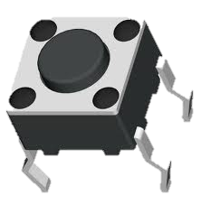
Specifications
Two positive integers (0~3) are inputted from tactile switches.
Below is the OP list.
000 : bypass A (7-segment shows the value of A)
001 : bypass B (7-segment shows the value of B)
010 : bitwise NOT A
011 : bitwise NOT B
100 : bitwise AND
101 : bitwise OR
110 : bitwise XOR
111 : ADD
A[1:0]
B[1:0]

Slide 4
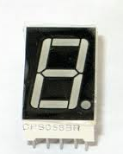
Specifications
OP is inputted from a DIP switch.
A 7-segment display displays the output.
Implement comparator for two inputs A and B. If two inputs are equal, turn on 7-segment display’s DOT. Otherwise, turn off 7-segment display’s DOT. Use 8:1 mux. (74150 is 16:1 mux. You should use only 3 control inputs.) Comparator should operate regardless of OP code.
The input switches for A, B, OP are implemented on the same board so that all functions can be performed on one board.

Slide 5
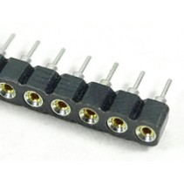
Specifications
Minimize the number of gates to use as fewer chips as possible.
NOT, AND, OR, XOR, 74150(16:1 Mux), 7448(7-segment decoder) can be used for the implementation.
Use round-sockets (for TTL chips and 7-segment).

Slide 6
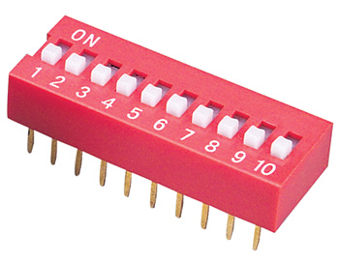
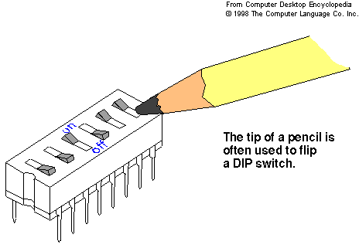
DIP Switch (OP-code input)
Simple ALU has 8 OP-codes.
You can use 3 switches.
You should construct pull-up resisters for switches.

Slide 7
Project Grading
Due : 7pm, April 30th
Behavior Correctness (60%)
Partial points will be given if your implementation operates incompletely.
Wiring/Soldering Quality (15%)
Report (15%)
Each group will turn in 1 report.
Contribution to the project (10%)
Generally, 50:50 contribution ratio is not allowed
In case of 50:50, list the specific contributions
Extra Implementation (max. 20%)
You can receive more points by implementing extra behaviors.
You can’t get extra points by adding more OP codes.

